Slide 1
Payroll & HR Solutions to Help You Grow
Access to Capital | Staying Compliant | Managing Talent

Slide 2
Payroll & HR
Should be ”Asure” Thing
More than software: Strength, Support, and Security

Slide 3


Growth is Asure Thing
Growth means more employees, more locations, more tax jurisdictions, and more HR laws. Asure can help small businesses grow because we fit that mold ourselves
By the Numbers
$123 to $129M
(2024 Guidance)
: ASUR
~100,000
Clients
Served
~1.7M
Employees Served
HQ
Austin, TX
~575
Employees⁽¹⁾
$10B+
Money Movement
93%
Client
Retention
$27M
2014
~455%
10-year Growth
All 50 States
8-10 Years
Growth Expertise
Insider Ownership
Clients and employees in all 50 States
Clients LOVE US –
Average Retention 8-10 YRS
Experience and resources that help small businesses scale
HIGH INSIDER OWNERSHIP FOR PUBLIC COMPANY

Slide 4


Asure’s Unique Support Model
Focused on the Client
Every client is assigned a dedicated, named team
Ownership for Accountability
US-based Hubs support local time zones; Satisfaction owned by named Hub leader
Organized for Teamwork
Company-wide resources, client facing and shared-services, aligned by Hub
Acct
Manager
Dedicated Resources by Hub
EAST
HUB
Rochester
Hub
Leader
Growth
Leader
Sales
Account Manager
Payroll, Tax,
& HR
Solution Consultant
Shared Services
Admin
Products
Implement-
ation
Client
Support
IT
Client
WEST
HUB
Santa Ana
CENTRAL
HUB
Nashville
Payroll,
Tax & HR
Implemen-tation
HQ
Austin
Hub Leaders own the client relationship
for ALL products

Slide 5







Data Security
Asure takes privacy and cybersecurity seriously. Through industry-recognized certifications and industry-leading cloud computing through AWS, we maintain the highest standards for data security.
SCALABLE
HIGH-PERFORMANCE
Using AWS tools, Auto Scaling, and Elastic Load Balancing, Asure can scale up or down based on demand while maintaining the highest security standards
Infrastructure Security
DDoS
Mitigation
Data
Encryption
AWS hosting increases privacy and controls network access.
Built from the ground up to provide resilience in the face of cyber attacks.
Additional layer of security; Your data is encrypted for safety in the cloud.
SOC1 & SOC2 Certified
Asure employees are required to undergo annual information security awareness training, which covers topics including CCPA, HIPPA, phishing, etc.
Monitoring
& Logging
Identity &
Access Control
Tools allow us to see exactly what’s happening in your environment.
Highest standards to define, enforce, and manage user access
Notes:
Amazon (add on another slide?), scalability, SOC

Slide 6
How do we ”Asure” Growth?
Growing a business requires financial & human capital

Slide 7



How we Asure Growth for Small and Mid-Sized Businesses
Staying Compliant
Explosion of new Federal, State, and Local HR laws is impossible to keep up with and creates a crushing administrative burden
Growth Requires
Human Capital & Financial Capital
Managing Talent
Labor shortage is making it harder to find talent and requires businesses to optimize workforce management processes
Access to Capital
Inflation, monetary policy, and rigid bank lending standards are making it difficult to fund a small business

Slide 8
Managing Talent
Small and mid-sized businesses need to attract, develop, and retain talented people to grow their business. To do that, they need great Human Capital Management tools.

Slide 9





Managing Talent
How Asure Can Help
Payroll & Tax
Services
Automate and outsource the complex management of wages, direct deposit, tax codes, and all payroll and tax functions to experts who ensure you remain compliant.
HR
Software
Eliminate manual data entry and paperwork for new hires. Easily onboard employees electronically with convenient e-signature to speed the process while remaining fully compliant.
Time & Attendance
Asure’s Time & Attendance software makes time collection, accruals and scheduling easy with modern tools that are both convenient and compliant.
Recruiting Software
Intuitive web-based solution helps you streamline the hiring process with an all-in-one solution for identifying and tracking candidates for your open positions.

Slide 10
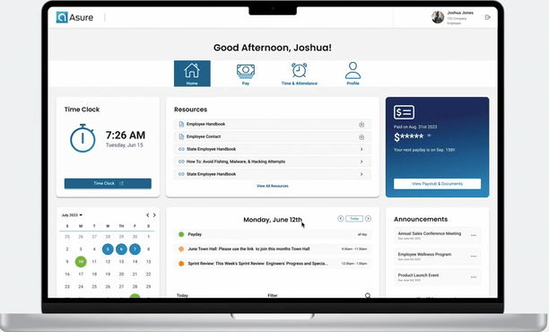
Payroll Solutions Tailored to Your Needs
From full-service payroll administration to to self-service tools that empower your employees to manage their own data
Whether you have a handful of employees or hundreds, the Asure payroll solution will keep pace with your needs as your business expands.
Employee Self-Service
100% Compliant Payroll Taxes
General Ledger Integration
Management Garnishments
ACA Compliance & Reporting
And much, much more
Notes:
Keep the GIF or swap out for still images of ESS on both desktop and mobile

Slide 11

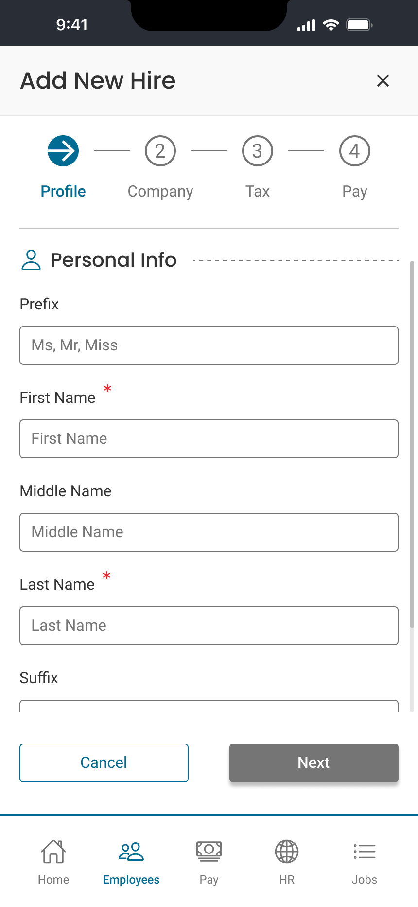
HR Software
Manage and track your staff throughout the employee lifecycle
Our comprehensive HR information system lets you stay organized and compliant with employee data stored in one, convenient tool. With Asure’s advanced HR software you can manage:
Paperless employee onboarding
Online open enrollment
I-9 Forms
W-4 Forms
Direct Deposits

Slide 12

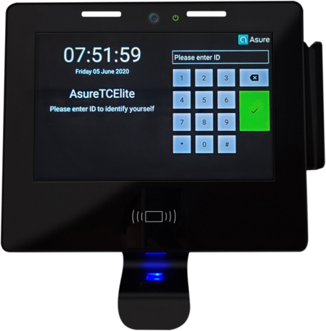

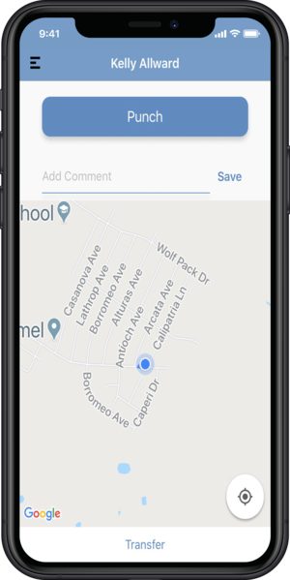




Time & Attendance
Easy, accurate time tracking
Flexible Time
Collection Options
Time tracking that fits your needs:
Mobile, PC, badge-reader, and biometric
Our enterprise-class time tracking capabilities built for the needs of small to mid-sized businesses. Easily manage time collection, accruals, and employee schedules while staying compliant.
FLSA Compliance
Consistent enforcement of pay policies and application of pay rules
Time-Off Management
Time off requests and approvals streamlined to keep managers working
Error-free Processing
Automated pay rule calculation for fast, accurate payroll processing
Manage by Exception
Stop reading every timecard and only deal with the exceptions
Notes:
Did you know that nearly 20% of the workforce participates in buddy punching in an average company costing U.S. employers an estimated $375 million each year? Time tracking systems save organizations huge amounts of time and by getting rid of errors, automating processes, and eliminating fraud.
Modern software features an intuitive supervisor dashboard, plus web and mobile employee interfaces.

Slide 13

Recruiting Software
Find top talent to support your growth
Asure Recruiting solution makes the entire hiring process easier and more accessible for employers and job seekers alike. The all-in-one solution delivers a seamless experience for:
AI-powered job descriptions
Automated posting to national job boards
Mobile-friendly job applications
Applicant tracking dashboard

Slide 14

Staying Compliant
US Chamber of Commerce survey:
Compared to six months ago, has the time or resources you spend completing licensing, compliance, or other govt’ requirements increased?*
^{% who answered “yes”}
* www.uschamber.com/sbindex/quarterly-spotlight

Slide 15





Staying Compliant
How Asure Can Help
HR Compliance Services
Off-load the administrative HR burden to certified HR pros and develop a talent strategy
Benefits
Administration
Eliminate the manual work administering COBRA, HSA, FSA, Worker’s Comp, and more
Proactive Health Management
Pre-tax health plan creates a healthier workforce while reducing claims & FICA cost
Affordable Care Act Reporting
ACA reporting has strict requirements and steep fines. Let us do it for you

Slide 16
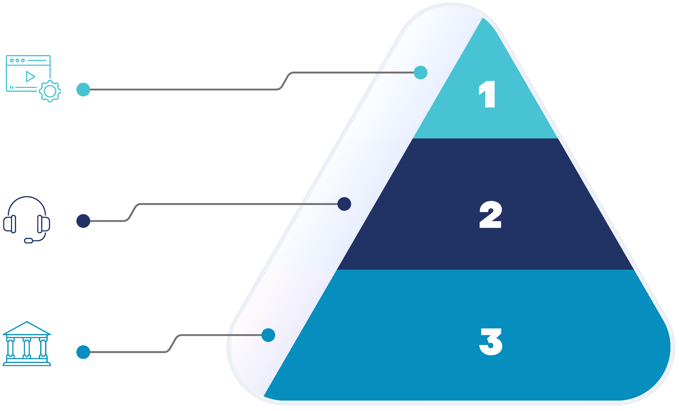
HR Compliance Services
Three levels of HR service to suit your needs and budget
For a fraction the cost of in-house HR staff, our certified HR experts reduce your administrative burden, help you stay compliant, and recruit, develop & retain the talent you need to grow.
Level 1
HR Support for Managers
On-demand resource library with 25 links for harassment training, phone & email support for managers, annual handbook (English & Spanish) review, creation and updates, compliance posters (English & Spanish), 2 background checks
Level 2
Strategic HR for Managers
All of L1, plus 50 links for harassment training, monthly meeting with dedicated HR consultant, 5 background checks, 6 total trainings or projects (HR audit, wage & hour review, interview training, etc.)
Level 3
Total HR for All Employees
All of L2, plus 100 links to harassment training, phone & email support for all employee relation issues, weekly meeting with dedicated HR consultant, 10 background checks, personalized compliance guidance, 6 custom trainings and 10 projects (job descriptions, I-9 audit, recruitment plan, salary benchmarking, onboarding, etc.)
Notes:
Describe details and types of projects for various HRC levels.
View more info on types of “Trainings” and types of “Projects” in this document: asuresoftware.sharepoint.com/sites/Intranet/Document Library/Forms/AllItems.aspx?id=%2Fsites%2FIntranet%2FDocument Library%2FHR Projects and Trainings_Nov 2023%2Epdf&parent=%2Fsites%2FIntranet%2FDocument Library&p=true&ga=1

Slide 17

Benefits Administration
Reduce the burden of benefits administration with cloud-based platform
Give employees a smart way to view, manage, and enroll in benefits
Asure’s streamlined online enrollment process reduces complexity
Ensure compliance with COBRA Administration services
Notes:
Provide employees a smart way to view, manage, and enroll in benefits. Asure’s streamlined online enrollment process reduces the complexity of benefits management.

Slide 18
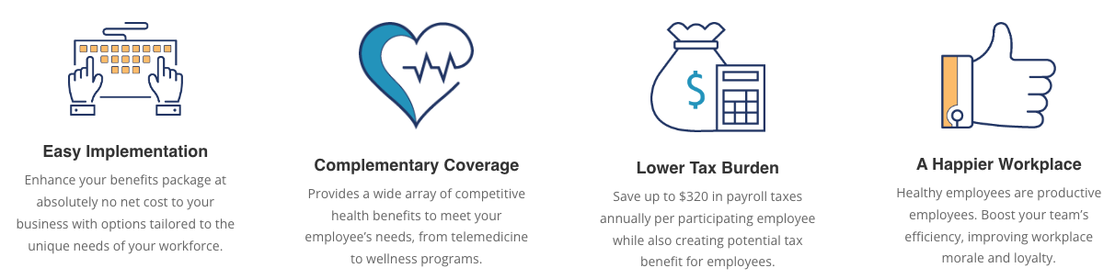
Proactive Health Management
Greater productivity from a healthy workforce all while lowering claims and reducing FICA expense with this pre-tax health benefit.

Slide 19

ACA Filing Services
Stay in compliance with accurate, on-time filing
The regulations surrounding the Affordable Care Act are complex and fines can be steep for not getting it right. Asure’s comprehensive ACA Filing services offer compliance peace of mind, while freeing you to focus on growth.
Eligibility Report
ACA Coding
1095 Form Printing
E-filing with the IRS
Notes:
With complicated filing requirements, numerous penalties, and fees calculated on a per-employee basis, non-compliance can get really expensive, really fast.
All required businesses must complete their ACA filings completely and accurately to avoid the significant penalties, which can easily add up to tens of thousands of dollars for non-compliance.
At Asure, our experienced team of ACA experts can help you check all the right boxes, while reducing the burden and manual entry requirements for you and your team—so you can focus on growth.

Slide 20
Access to Capital
A majority of owners rely on personal savings (71%) and credit cards (67%) as the top sources for funding their small businesses.
– US Chamber of Commerce

Slide 21




Access to Capital
How Asure Can Help
Employer
Tax Credits
3,000+ federal, state, and local employer tax credits and incentives can be the growth capital you need
401(k)
Tax Credits
The Secure Act 2.0 passed Congress to create financial stability for employees and incentivizes employers to establish a 401(k)
Small Business
Lending
Through our partnership with Lendio, Asure connects clients to lending options that are tailor made for small businesses.

Slide 22

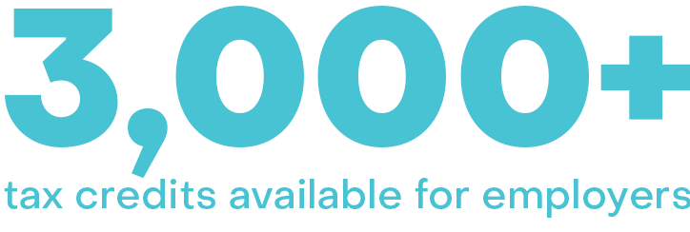

Little Known
Employer Tax Credits
$1B claimed annually from ~$65B available
Work Opportunity Tax Credits (WOTC) worth up to $9,600 per new hire
Small businesses are underrepresented due to perceived complexity and time constraints
Most employers unaware of the amount of ‘free capital’ that’s available to them
Investment Tax Credits
Property Tax Abatements
Veteran Hiring Tax Credits
Film Production Tax Credits
Quality Jobs Tax Credits
Workforce Development
Incumbent Worker Training
Headquarters Tax Credits
Sales & Use Tax Credits
Payroll Tax Rebates
Utility Rate Reductions
High Wage Job Creation
Infrastructure Resources
Environmental Tax Credits
State R&D Credits
Expedited Permits
Land Grants
Training Grants
Take the free eligibility assessment!
Powered by
Notes:
Featured solution: Employer Tax Credits
Tax credits are complex but our free assessment is easy!
Capital to Support Your Growth
Did you know that the U.S. government offers more than 3,000 state and federal incentive programs? These incentives reward business owners for basic business functions like retaining employees, job creation, innovating internal processes, and more.
While these tax credits are leveraged by every fortune 500 company to offset their tax liability and invest in the growth of their business, small business owners routinely miss out on these capital-boosting opportunities. Asure’s partnership with HRlogics democratizes tax credit access, allowing small and midsized businesses access to tax credit capital normally reserved for global enterprises.
3 Reasons to Claim Tax Credits:
1. Tax credits can significantly reduce your business's tax liability, allowing you to keep more of your profits.
2. They provide financial incentives for specific activities or investments that benefit the economy or society, such as hiring veterans, investing in research and development, or using renewable energy.
3. By taking advantage of tax credits, you can offset the costs of certain business expenses, making it more affordable to innovate, expand, or improve your operations.

Slide 23

401(k) Tax Credits
Claim Small Business Tax Credits by setting up a retirement plan for your employees
SECURE Act 2.0 legislation passed to enhance retirement security and incentivize employers to offer 401(k)
Set up a 401(k) plan and earn credits
up to 100% of your start up and admin costs for the first three years
Offer an employer match for additional tax credits up to $1,000 per employee
FREE 401(k)
for first two years
Claim credits up to $5,000
in $401(k) start up costs + up to $1,000 employer match
Notes:
Establish a retirement plan for your small business employees and claim tax credits for empowering your team to have a more secure financial future.
A made-for-small-business 401(k) plan not only supports your employees financial future, it can have tax benefits for your organization, as well as help you remain compliant. Did you know that 45 states have passed or are considering mandates that requires employers of all sizes to offer retirement plans?
SECURE Act 2.0 is a legislation designed to enhance retirement security amid the changing landscape of retirement savings in the United States. One of the key components of the act is to encourage employer participation in retirement planning.
This legislation incentivizes small businesses to offer retirement plans to their employees by providing tax benefits and simplifying administrative requirements. By doing so, it aims to expand retirement savings opportunities and ensure more workers have access to employer-sponsored retirement plans.

Slide 24

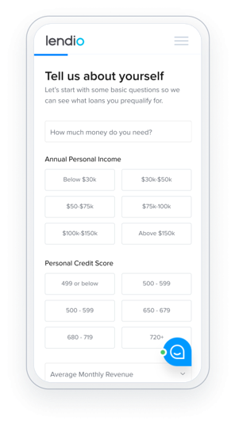

Small Business Lending
The average small business owner spends 26 hours approaching 3 lenders.
Let a nationwide network of banks compete for your business
Less than 20% of small business loans are approved at local banks
Asure’s partner Lendio offers a proven alternative to bank loans
Connect with multiple lenders via one, simple online application process
Powered by
Notes:
Many small businesses turn to their local banks to seek funding. The harsh reality is that these banks rarely approve loans for small businesses. In fact, less than 20% of small business loans are approved at local banks, which means more than 80% of business owners are declined the funds they need to help their business grow.
There is a better way.
Asure has partnered with Lendio, a proven provider with more than a decade of experience in helping small business owners access to the capital you need to support your growth journey.
Lendio is the nation’s leading small business financial solutions provider, with a mission to help small businesses survive and thrive. With its diverse network of lenders, Lendio enables small business owners to apply for multiple business financing options with a single application.

Slide 25
Next Steps
Now that you see how we can “Asure” your growth, what’s next?

Slide 26
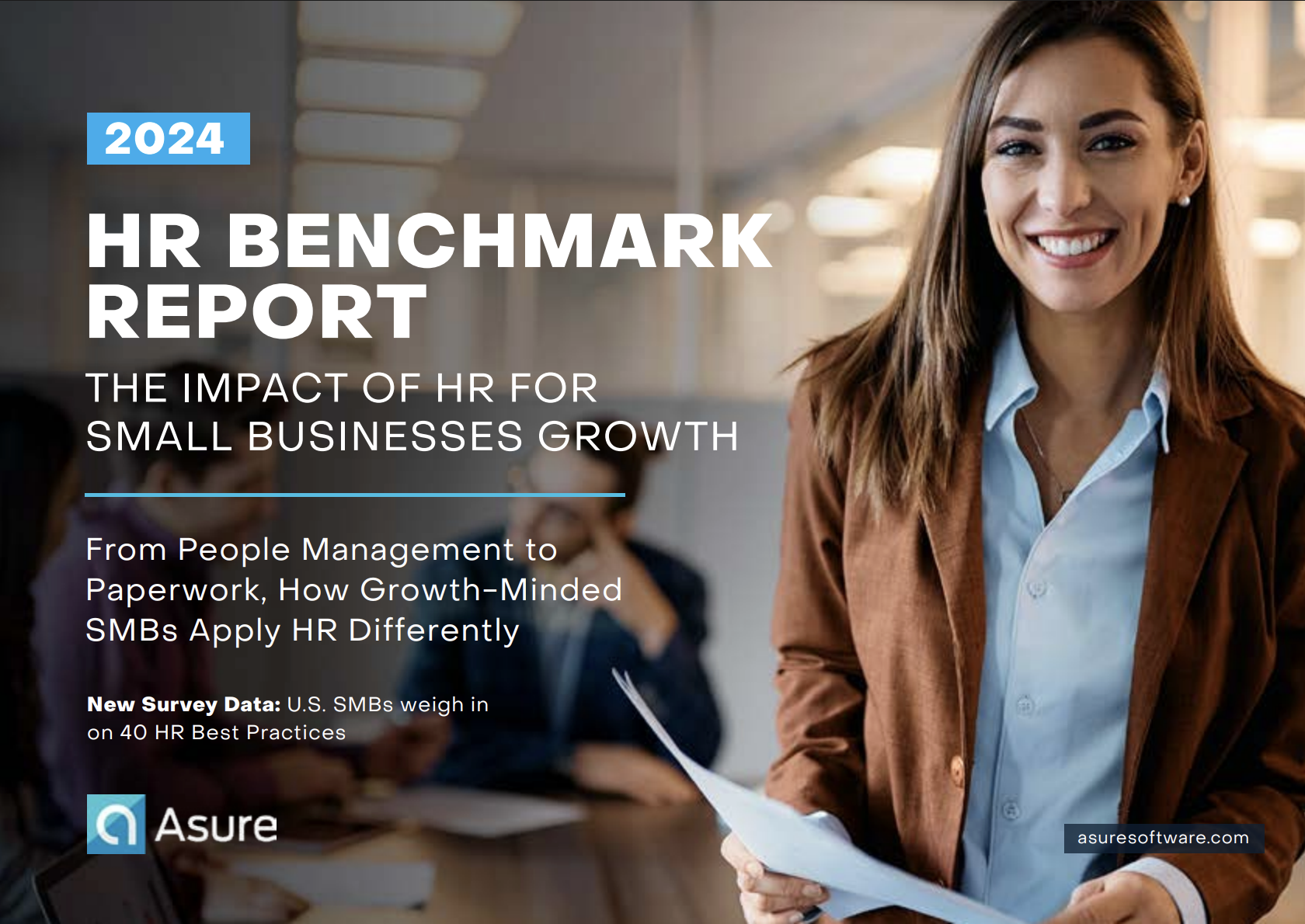
Schedule GROW Meeting
(Goals, Results, and Opportunities Workshop)
Review business goals and current results
Discuss areas concern or opportunity
Benchmark performance against America’s fastest goring business in eight key areas:
Recruiting & Hiring
Benefits
Onboarding
Development
Compliance
Retention
Performance
Post-Employment

Slide 27
Notes:
Insert contact details – reps should personalize
Asure Headquarters​
Address: 405 Colorado Street, Suite 1800, Austin, TX 78701​
Phone: (888) 323-8835​
Email: askasure@asuresoftware.com​
Website: www.asuresoftware.com​
Social Media:​
LinkedIn: LinkedIn​
Twitter: https://twitter.com/Asure_Software​
Facebook: Facebook​
YouTube: Asure Software - YouTube​
Mission To Grow Podcast: https://missiontogrow.asuresoftware.com/subscribe​
​
ails

