Slide 1
Payroll & HR for Growing Businesses
Prepared for: <business name>
on <date>

Slide 2

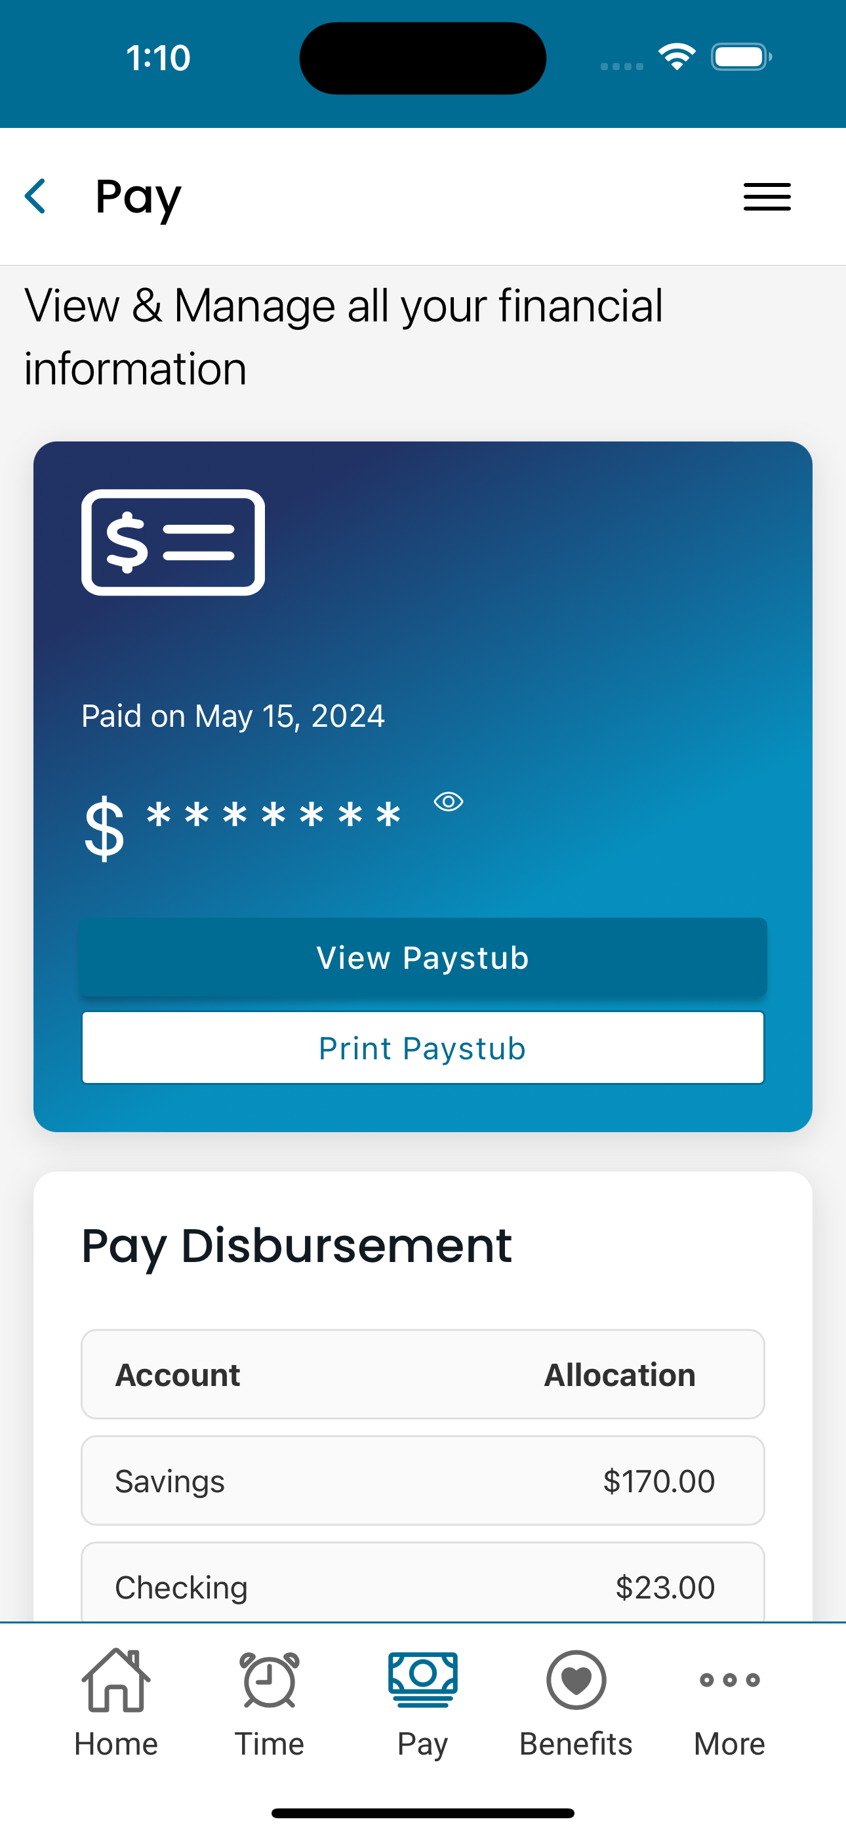
Agenda
Align on Mission, Vision, and Values
Summarize:
  Goals
  Current State
  Challenges & Opportunities
Proposed Solution
Why Asure is the Right Partner
  Relieve the Admin Burden
  Money Talks
  Better Support
  Delivers on Promises
  Asure Knows Growth

Slide 3
Our Mission
Our Vision
Be the most trusted Human Capital Management resource to entrepreneurs everywhere.
Our Values
Embrace Change
Lead with Integrity
Own the Outcome
Deliver Awesome
Be a Good Human
Provide Human Capital Management software and services that help
companies grow, while nurturing
a culture of growth around us.

Slide 4
Summarize Goals, Current State, and Opportunities for Growth
Goals, Current State, & Opportunities

Slide 5
Business Strategy
  Business Profile
  Years in business: 18
  Industry: Restaurant
  # Employees: 20
    8 Full-time
    12 Part-time
  # of Locations: 1
  Description:
    Family-owned business with parents no longer running day to day but still active in decision making
    Local favorite with more than 500 Google reviews
Plans to Grow
  Business never fully recovered from the pandemic shutdowns. The restaurant is running about 80% of capacity with room to grow revenue by roughly 20% without adding additional overhead expense.
  Would also like to expand DoorDash and UberEats business
  Will need to add 2-3 full time people and 3-4 part-time staff to meet growth needs
Obstacles preventing growth
Can’t keep up with the administrative burden
Too busy working in the business vs on the business
Struggle finding employees willing to work hard and show up on time
Opportunities
Improve the recruiting function to find more, better workers
Add earned wage access to better compete for talent and meet employee’s needs
Streamline the end to end process of hiring, managing, and paying employees
Adding more employees brings new compliance risks
Explore pre-tax benefits to attract talent and reduce FICA
Notes:
Summarize what you learned in the Business Strategy portion of the GROW guide on page #5

Slide 6



Current State
 | Category | Provider
Managing Talent | Payroll & Tax | Paychex
 | HR Software | Paychex
 | Time & Labor | Point of sale
 | Recruiting | Toast
Staying Compliant | Outsourced HR Team | Google
 | Online HR Library | No benefits to admin
 | Benefits Admin | State IRA
 | 401(k) Admin | N/A <50 employees
Access to Capital | Employer Tax Credits | None applied for
 | 401(k) Tax Credits | N/A no 401(k)
 | Pre-tax Benefits | None; Cash flow & credit card(s)
 | Lending | None
Managing
Talent
Staying
Compliant
Growth Requires
Human Capital & Financial Capital
Access to Capital
Notes:
Stripe the providers they use for each of our product categories – even if they’re not using any vendor in that area yet. Reminding buyers of the things they don’t have can be a powerful primer for the solutions you’ll be presenting in this presentation.

Slide 7
Capabilities Needed
Employee Lifecycle Challenges |  | Asure Capabilities
Recruiting & Hiring Benefits Onboarding Development Compliance Retention Performance Post-Emp | Struggling finding employees willing to work hard and show up to shifts Struggle competing for employees since minimum wage has gone up to $15 so people can work easier jobs for similar money – need to incentives to recruit Currently not offering benefits Paper onboarding process is time consuming and not the best ”first day experience” for new employees | Salary Benchmarking Applicant tracking Background checks Proactive Health Management
Service Provider Challenges |  | Asure Capabilities
Service Quality Capabilities | Paychex rep has changed 7 times in past two years People are nice and helpful once trained but it feels like just about when they start learning my account, they leave and I have to start over again | Dedicated U.S. based, support team Teams organized by geography to support local time zone Teams organized by Asure Hub to ensure local executive ownership and accountability

Slide 8
Proposed Solution
Choosing the plan with the services that meet your needs

Slide 9
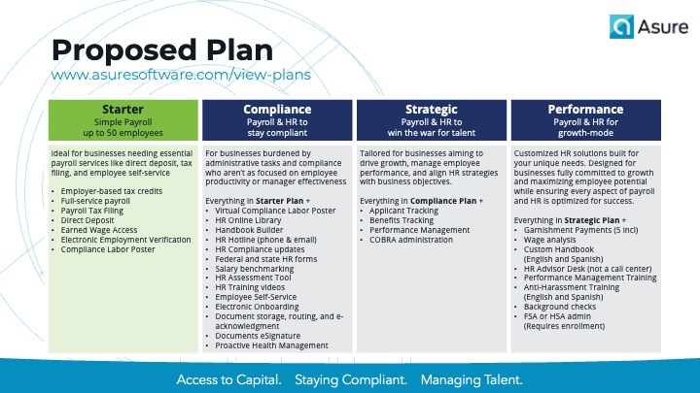
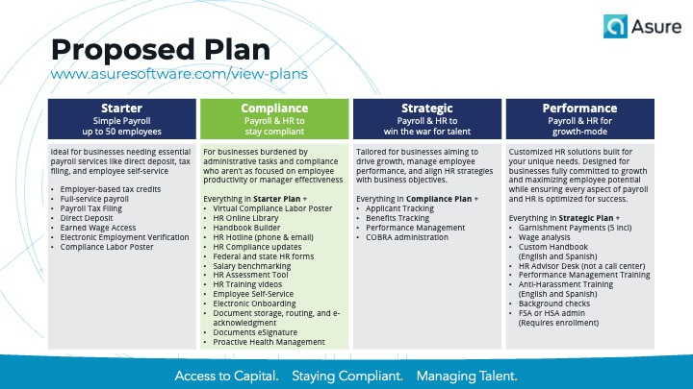
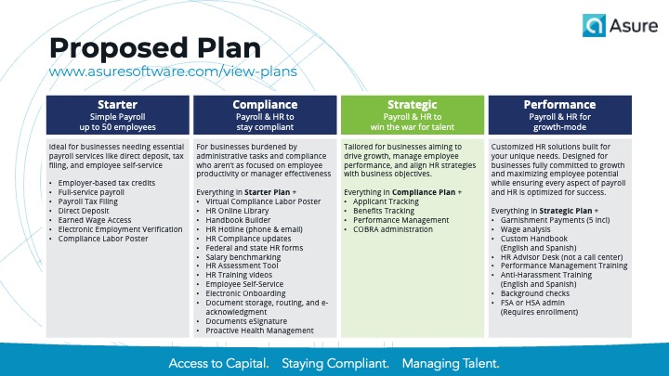
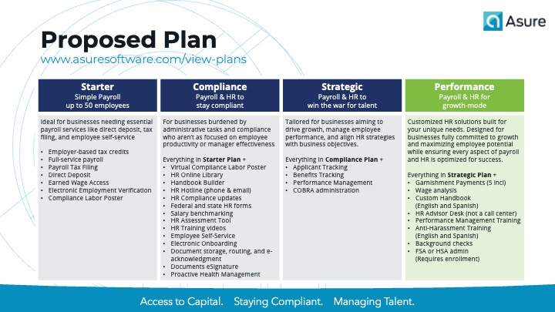
Choosing the right plan
Choose “Proposed Plan”
& Delete Other Slides
Insert appropriate “Proposed Plan” slide from the appendix at the end of this presentation

Slide 10
Proposed Plan www.asuresoftware.com/view-plans
Starter Simple Payroll up to 50 employees | Compliance Payroll & HR to stay compliant | Strategic Payroll & HR to win the war for talent | Performance Payroll & HR for growth-mode
Ideal for businesses needing essential payroll services like direct deposit, tax filing, and employee self-service. Employer-based tax credits Full-service payroll Payroll Tax Filing Direct Deposit Earned Wage Access Electronic Employment Verification Compliance Labor Poster | For businesses burdened by administrative tasks and compliance who aren’t as focused on employee productivity or manager effectiveness. Everything in Starter Plan + Virtual Compliance Labor Poster HR Online Library Handbook Builder HR Hotline (phone & email) HR Compliance updates Federal and state HR forms Salary benchmarking HR Assessment Tool HR Training videos Employee Self-Service Electronic Onboarding Document storage, routing, and e-acknowledgment Documents eSignature Proactive Health Management | Tailored for businesses aiming to drive growth, manage employee performance, and align HR strategies with business objectives. Everything in Compliance Plan + Applicant Tracking Benefits Tracking Performance Management COBRA administration | Customized HR solutions built for your unique needs. Designed for businesses fully committed to growth and maximizing employee potential while ensuring every aspect of payroll and HR is optimized for success. Everything in Strategic Plan + Garnishment Payments (5 incl) Wage analysis Custom Handbook (English and Spanish) HR Advisor Desk (not a call center) Performance Management Training Anti-Harassment Training (English and Spanish) Background checks FSA or HSA admin (Requires enrollment)

Slide 11
Proposed Plan www.asuresoftware.com/view-plans
Starter Simple Payroll up to 50 employees | Compliance Payroll & HR to stay compliant | Strategic Payroll & HR to win the war for talent | Performance Payroll & HR for growth-mode
Ideal for businesses needing essential payroll services like direct deposit, tax filing, and employee self-service. Employer-based tax credits Full-service payroll Payroll Tax Filing Direct Deposit Earned Wage Access Electronic Employment Verification Compliance Labor Poster | For businesses burdened by administrative tasks and compliance who aren’t as focused on employee productivity or manager effectiveness. Everything in Starter Plan + Virtual Compliance Labor Poster HR Online Library Handbook Builder HR Hotline (phone & email) HR Compliance updates Federal and state HR forms Salary benchmarking HR Assessment Tool HR Training videos Employee Self-Service Electronic Onboarding Document storage, routing, and e-acknowledgment Documents eSignature Proactive Health Management | Tailored for businesses aiming to drive growth, manage employee performance, and align HR strategies with business objectives. Everything in Compliance Plan + Applicant Tracking Benefits Tracking Performance Management COBRA administration | Customized HR solutions built for your unique needs. Designed for businesses fully committed to growth and maximizing employee potential while ensuring every aspect of payroll and HR is optimized for success. Everything in Strategic Plan + Garnishment Payments (5 incl) Wage analysis Custom Handbook (English and Spanish) HR Advisor Desk (not a call center) Performance Management Training Anti-Harassment Training (English and Spanish) Background checks FSA or HSA admin (Requires enrollment)

Slide 12
Proposed Plan www.asuresoftware.com/view-plans
Starter Simple Payroll up to 50 employees | Compliance Payroll & HR to stay compliant | Strategic Payroll & HR to win the war for talent | Performance Payroll & HR for growth-mode
Ideal for businesses needing essential payroll services like direct deposit, tax filing, and employee self-service. Employer-based tax credits Full-service payroll Payroll Tax Filing Direct Deposit Earned Wage Access Electronic Employment Verification Compliance Labor Poster | For businesses burdened by administrative tasks and compliance who aren’t as focused on employee productivity or manager effectiveness. Everything in Starter Plan + Virtual Compliance Labor Poster HR Online Library Handbook Builder HR Hotline (phone & email) HR Compliance updates Federal and state HR forms Salary benchmarking HR Assessment Tool HR Training videos Employee Self-Service Electronic Onboarding Document storage, routing, and e-acknowledgment Documents eSignature Proactive Health Management | Tailored for businesses aiming to drive growth, manage employee performance, and align HR strategies with business objectives. Everything in Compliance Plan + Applicant Tracking Benefits Tracking Performance Management COBRA administration | Customized HR solutions built for your unique needs. Designed for businesses fully committed to growth and maximizing employee potential while ensuring every aspect of payroll and HR is optimized for success. Everything in Strategic Plan + Garnishment Payments (5 incl) Wage analysis Custom Handbook (English and Spanish) HR Advisor Desk (not a call center) Performance Management Training Anti-Harassment Training (English and Spanish) Background checks FSA or HSA admin (Requires enrollment)

Slide 13
Proposed Plan www.asuresoftware.com/view-plans
Starter Simple Payroll up to 50 employees | Compliance Payroll & HR to stay compliant | Strategic Payroll & HR to win the war for talent | Performance Payroll & HR for growth-mode
Ideal for businesses needing essential payroll services like direct deposit, tax filing, and employee self-service. Employer-based tax credits Full-service payroll Payroll Tax Filing Direct Deposit Earned Wage Access Electronic Employment Verification Compliance Labor Poster | For businesses burdened by administrative tasks and compliance who aren’t as focused on employee productivity or manager effectiveness. Everything in Starter Plan + Virtual Compliance Labor Poster HR Online Library Handbook Builder HR Hotline (phone & email) HR Compliance updates Federal and state HR forms Salary benchmarking HR Assessment Tool HR Training videos Employee Self-Service Electronic Onboarding Document storage, routing, and e-acknowledgment Documents eSignature Proactive Health Management | Tailored for businesses aiming to drive growth, manage employee performance, and align HR strategies with business objectives. Everything in Compliance Plan + Applicant Tracking Benefits Tracking Performance Management COBRA administration | Customized HR solutions built for your unique needs. Designed for businesses fully committed to growth and maximizing employee potential while ensuring every aspect of payroll and HR is optimized for success. Everything in Strategic Plan + Garnishment Payments (5 incl) Wage analysis Custom Handbook (English and Spanish) HR Advisor Desk (not a call center) Performance Management Training Anti-Harassment Training (English and Spanish) Background checks FSA or HSA admin (Requires enrollment)

Slide 14
Why is Asure?
Choosing the right partner requires more than alignment on product capabilities

Slide 15

When it comes to growth, people and cash are scarce. Put all your people and money into growth and leave the admin burden to us.
– Pat Goepel, Chairman and CEO at Asure

Slide 16
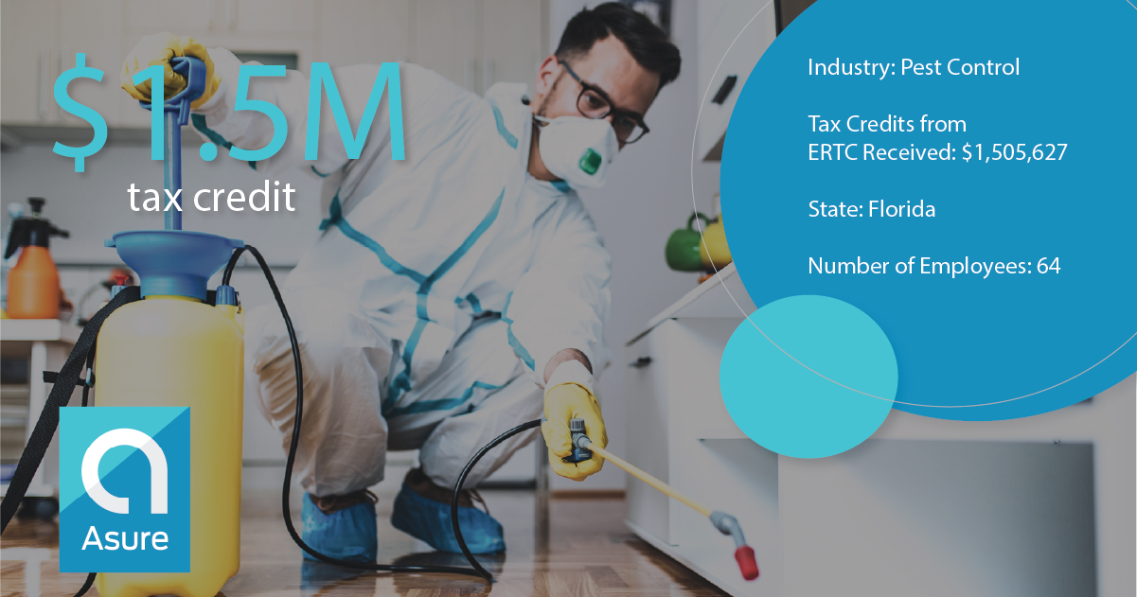














Why Asure? Money Talks
Asure has helped thousands of small businesses access more than $1 Billion in employer tax credits

Slide 17


Why Asure? Better Support
Focused on the Client
Every client is assigned a dedicated, named team
Ownership for Accountability
US-based Hubs support local time zones; Satisfaction owned by named Hub leader
Organized for Teamwork
Company-wide resources, client facing and shared-services, aligned by Hub
Acct
Manager
Dedicated Resources by Hub
EAST
HUB
Rochester
Hub
Leader
Growth
Leader
Sales
Account Manager
Payroll, Tax,
& HR
Solution Consultant
Shared Services
Admin
Products
Implement-
ation
Client
Support
IT
Client
WEST
HUB
Santa Ana
CENTRAL
HUB
Nashville
Payroll,
Tax & HR
Implemen-tation
HQ
Austin
Hub Leaders own the client relationship
for ALL products

Slide 18







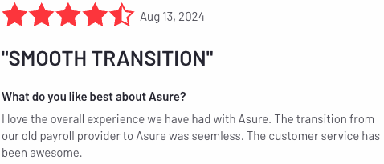
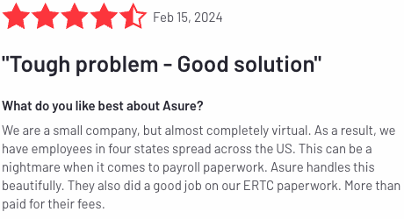
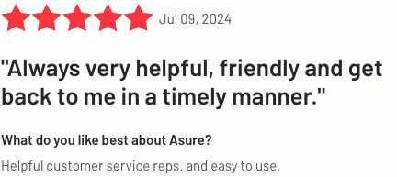
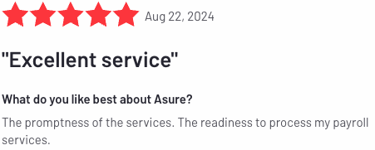
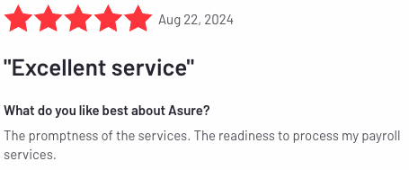
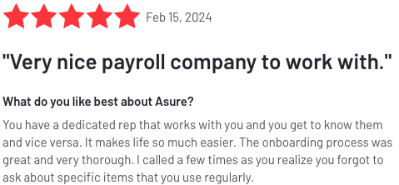
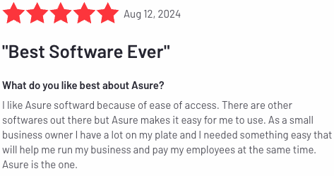
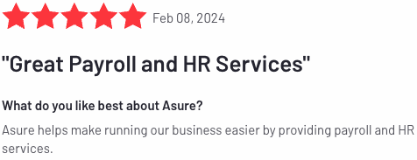
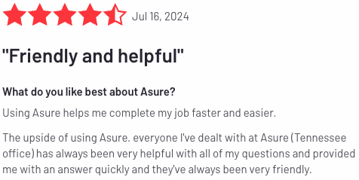

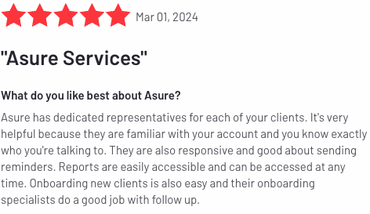
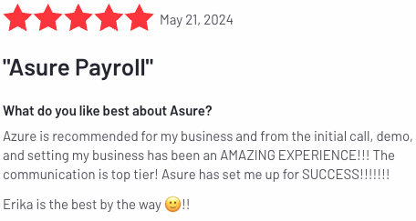
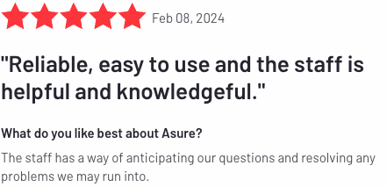
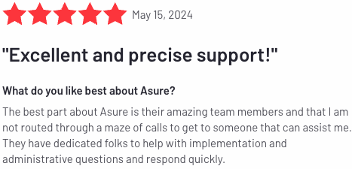
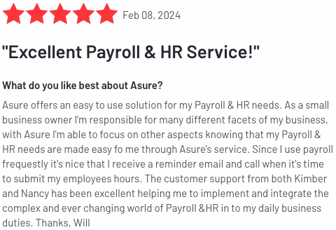
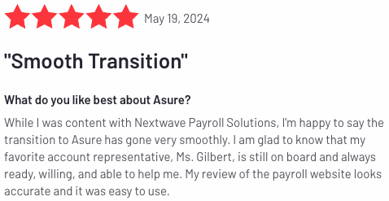
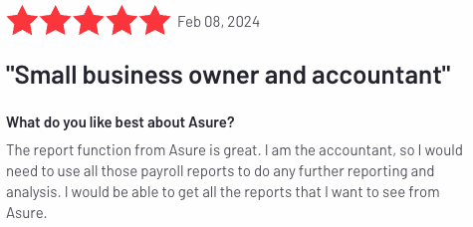
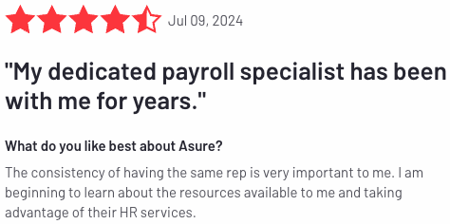
Why Asure? Deliver on Promises

Slide 19


Why Asure? We know Growth
Public company strength with a small business attitude. Growth means more employees, more locations, more tax jurisdictions, and more HR laws. Asure can help small businesses grow because we fit that mold ourselves.
By the Numbers
$123 to $129M
(2024 Guidance)
: ASUR
~100,000
Clients
Served
~1.7M
Employees Served
HQ
Austin, TX
~575
Employees⁽¹⁾
$10B+
Money Movement
93%
Client
Retention
$27M
2014
~455%
10-year Growth
All 50 States
8-10 Years
Growth Expertise
Insider Ownership
Clients and employees in all 50 States
Clients LOVE US –
Average Retention 8-10 YRS
Experience and resources that help small businesses scale
HIGH INSIDER OWNERSHIP FOR PUBLIC COMPANY

